Slide 1
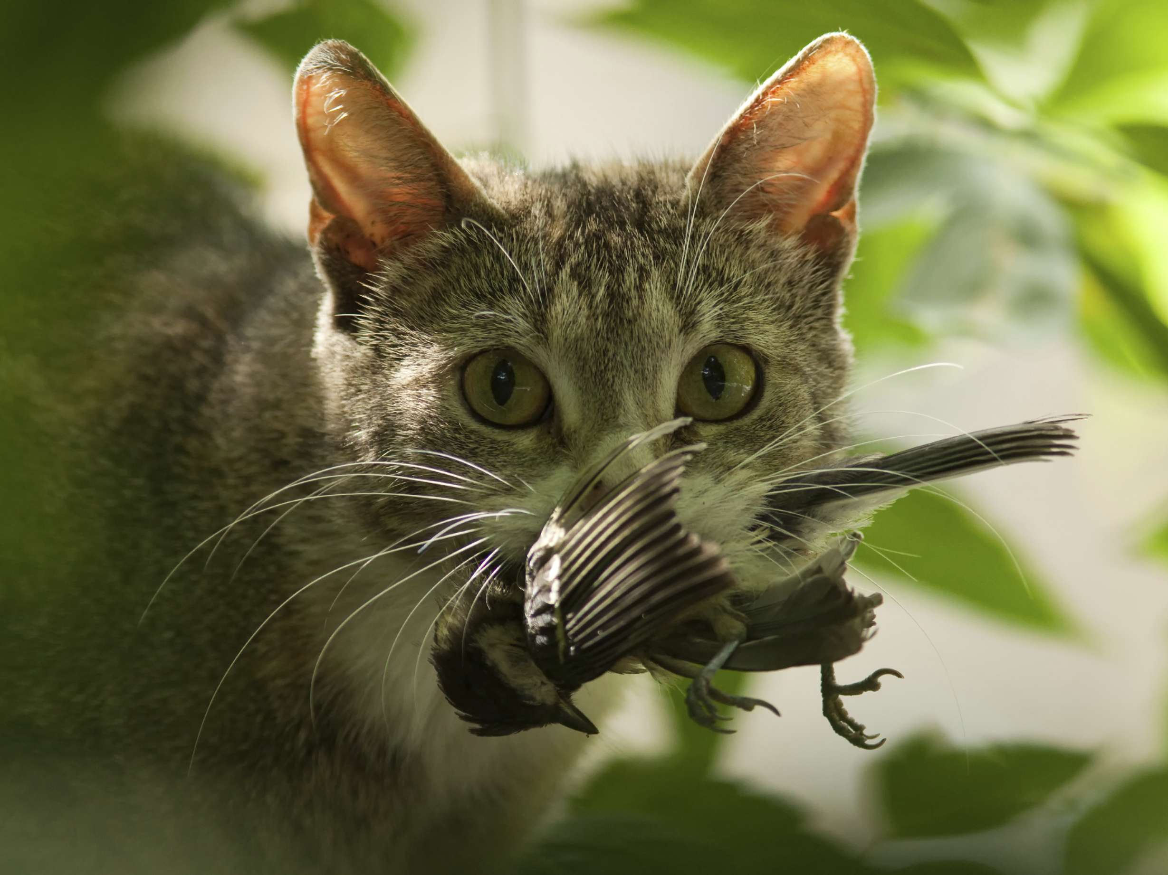
The Problem
Domestic cats are hunting and killing many species of wild birds and small mammals at alarming rates.

Slide 2
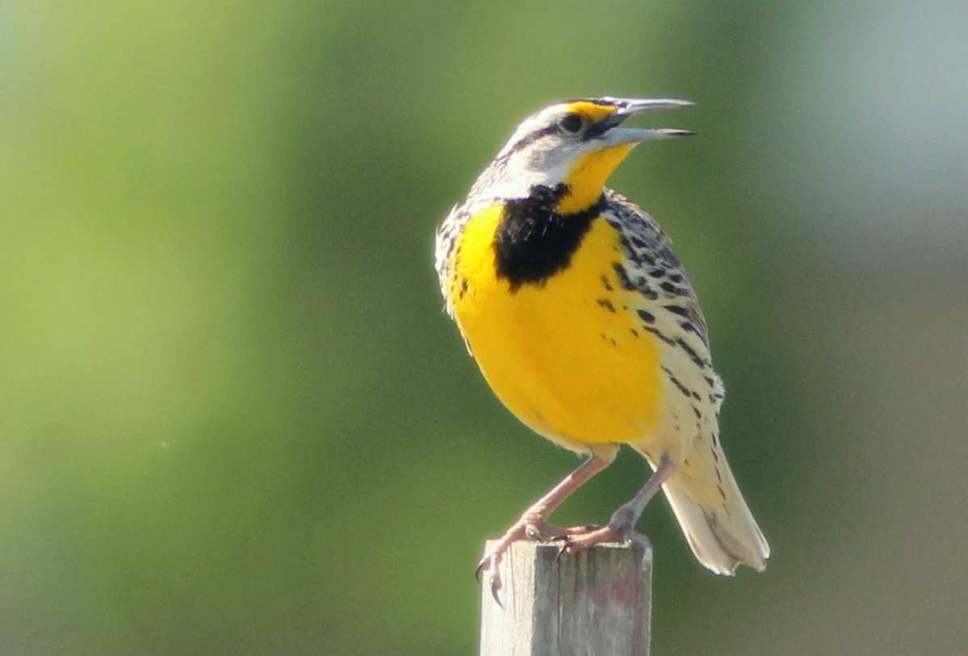
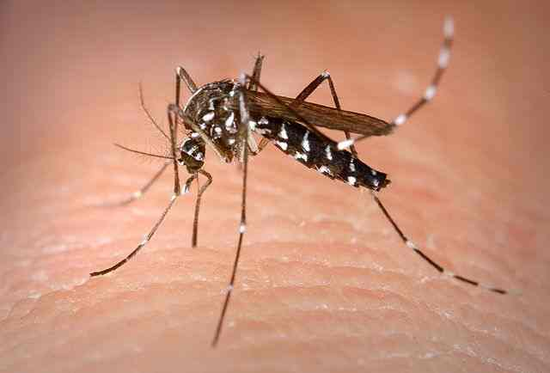

Consequences
Species Extinction
Cats have already hunted at least 33 bird species to extinction. They may be driving many more into decline.
1
Insect Populations
Birds help control insects. Predation by cats can mean more damage to crops and more insect-borne disease.
2
Public Health
Outdoor cats can spread diseases such as rabies and toxoplasmosis. This threatens humans, pets, and wildlife.
3

Slide 3
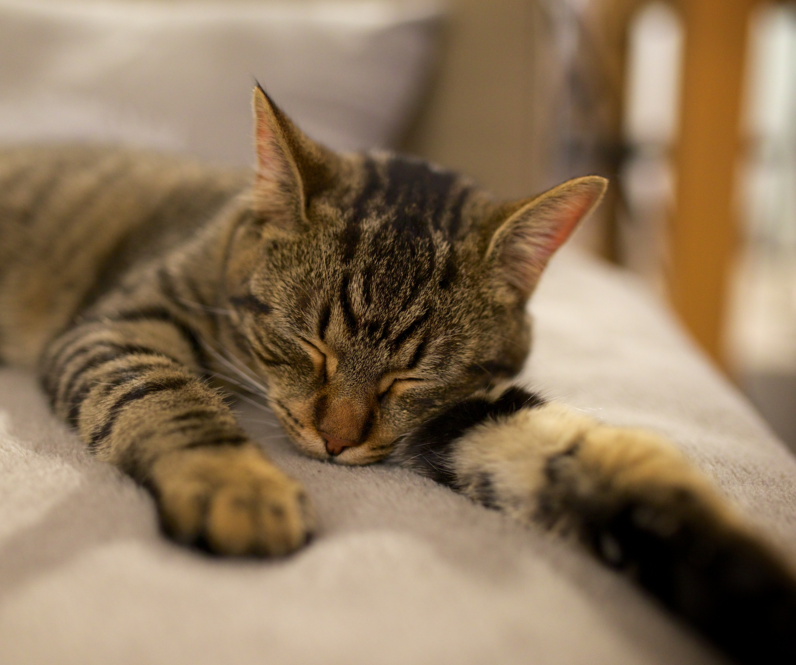
1
What Can You Do about It?
Keep Cats Indoors
Ensure the safety of cats and wildlife by keeping cats indoors.
Allowing cats outdoors threatens the lives of the animals cats prey upon. It can also shorten the lifespan of the cats themselves. Car traffic, poison-tainted prey, disease, and risky hunting behavior put cats at risk of early death.

Slide 4
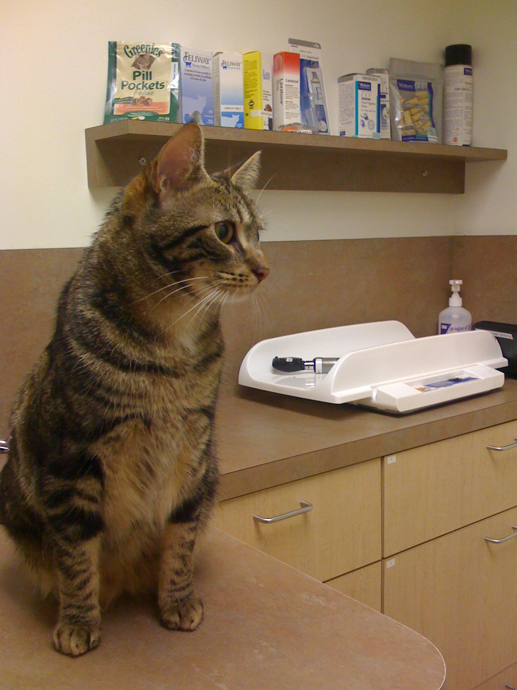
2
What Can You Do about It?
Spay / Neuter Your Pet
Indoor pets can sometimes escape. Sterilize your pet so that if it gets out by accident, it won’t contribute offspring to the feral cat population.
If you see feral cats nearby, notify someone. There are many programs and organizations that trap, sterilize, and then release feral cats.

Slide 5
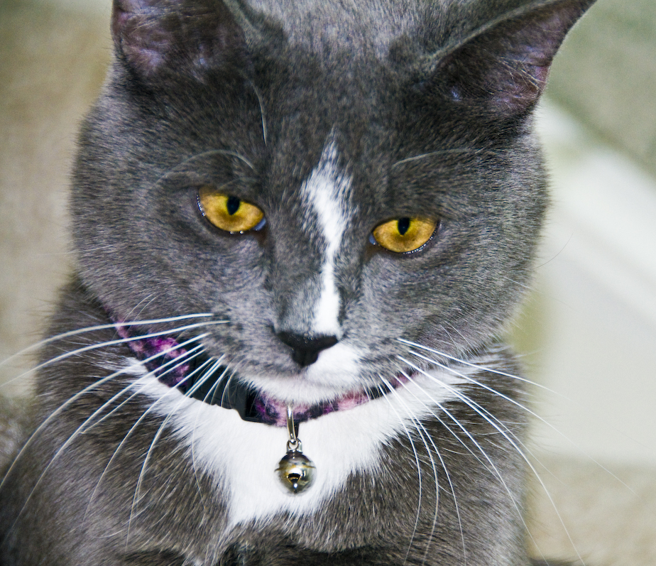
3
What Can You Do about It?
Sound the Alarm
Get the word out about the dangers of feral and outdoor cats.
If your cat must be outside, put a bell on your cat’s collar.
A bell can sometimes alert prey that a predator is nearby. The advance warning can help small animals escape serious injury or death.

Slide 6
Credits
All photos used under Creative Commons licenses:
https://creativecommons.org/licenses/by-nc-sa/2.0/legalcode
“Eastern Meadowlark 20110522” by Kennet hCole Schenider via flickr.com (cropped)
https://creativecommons.org/licenses/by-sa/2.0/legalcode
“Asian Tiger Mosquito, Aedes albopictus” by microbiologybytes via flickr.com
https://creativecommons.org/licenses/by-nc-nd/2.0/legalcode
”Checking Blood Sample” by National Eye Institute via flickr.com (cropped)
https://creativecommons.org/licenses/by/2.0/legalcode
“Ce Soir, on a un Invité Surprise” by LoKan Sardari via flickr.com
“Ozu at the Vet” by Greg Dunlap via flickr.com
“Bella” by Gary Garcia via flickr.com

